Slide 1
Data Visualization of Bird Strikes between 2000 – 2011
UNIFIED MENTOR INTERNSHIP – PROJECT 2
BY
M POOJA

Slide 2
CONTENTS
Introduction
Problem statement
Methodology Used
Inferences
Conclusion

Slide 3
INTRODUCTION
The Bird Strikes project focuses on analyzing data related to bird strikes, specifically collisions between birds and aircraft during flight or on take-off or landing.
The dataset, collected by the FAA between 2000-2011, provides insights into the frequency and impact of these incidents, including details about the aircraft involved, altitude, phase of flight, environmental conditions, and the outcomes of the strikes.
The objective is to understand the patterns, risks, and potential safety measures associated with bird strikes, utilizing Python for data analysis and visualization.
The project aims to contribute to aviation safety by extracting meaningful information from the dataset and providing a comprehensive overview of bird strike incidents over the specified period.

Slide 4
METHODOLOGY USED
The methodology employed in the Bird Strikes project involves a structured approach to analyzing and interpreting the dataset collected by the FAA between 2000-2011. The key steps include
data importing, cleaning, and preprocessing to ensure data quality and integrity.
Python is used as the primary programming language, and libraries such as pandas, matplotlib, and numpy are utilized for data manipulation, analysis, and visualization.
The analysis explores various aspects of bird strikes, including yearly trends, the top airlines and airports affected, the altitude of aircraft during strikes, and the impact on flight phases.
Descriptive statistics and visualizations, such as bar charts, pie charts, and area charts, are employed to present the findings effectively.
The goal is to gain insights into the patterns and factors contributing to bird strikes, providing valuable information for aviation safety and decision-making.

Slide 5
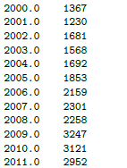
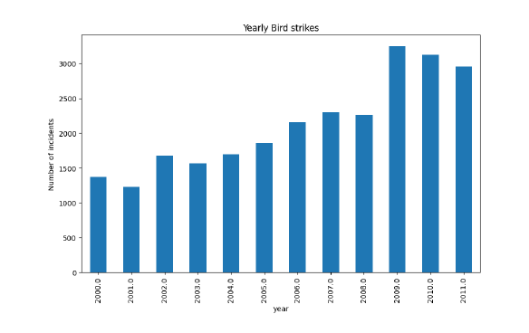
INFERENCES
YEARLY ANALYSIS

Slide 6
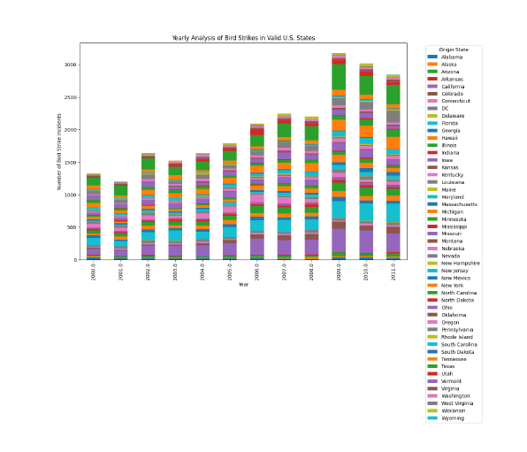
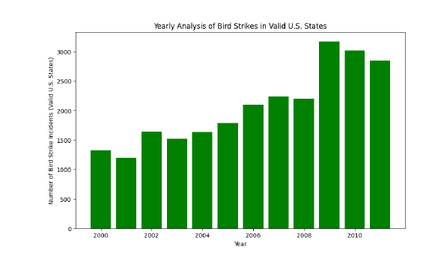
Yearly Analysis & Bird strikes in US

Slide 7
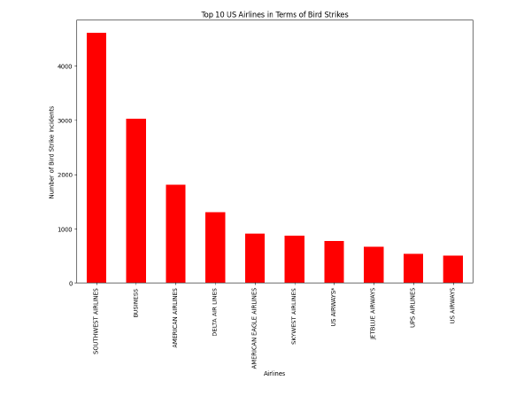
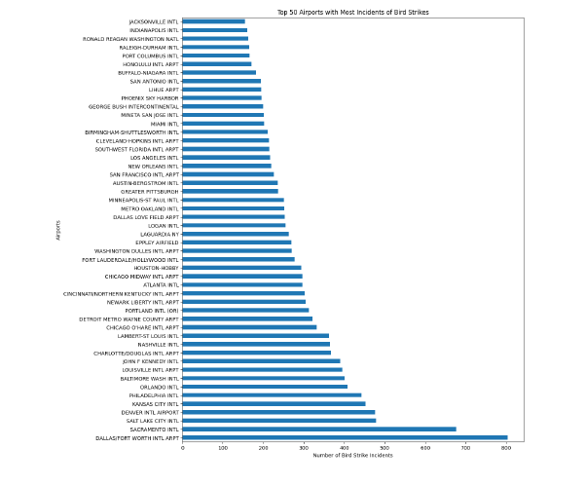
Top 10 US Airlines for encountering bird strikes
Top 50 Airports with most incidents of bird strikes

Slide 8
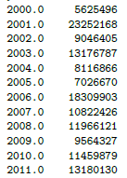
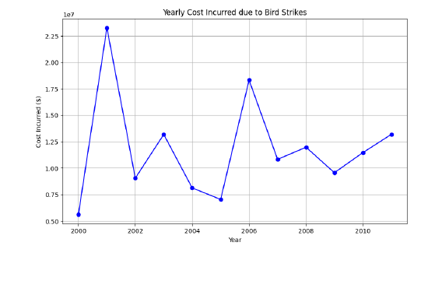
Yearly cost incurred due to bird strikes

Slide 9
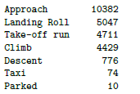
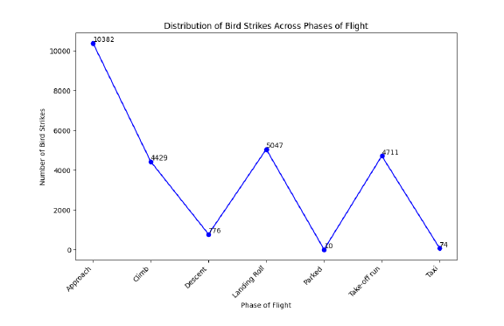
When do most bird strikes occur?

Slide 10
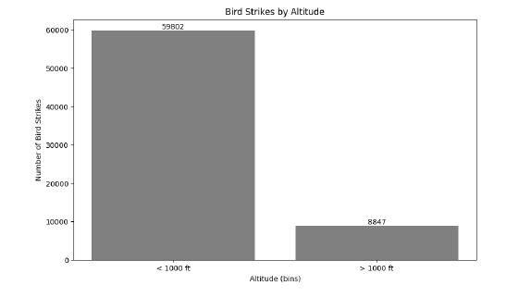
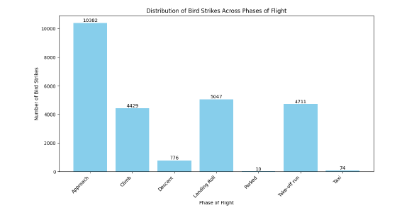
Altitude of aeroplanes at the time of strike
Phase of flight at the time of strike

Slide 11
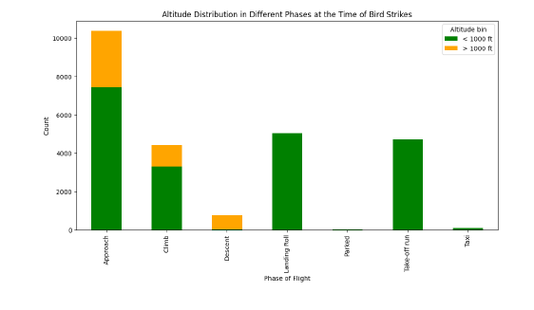
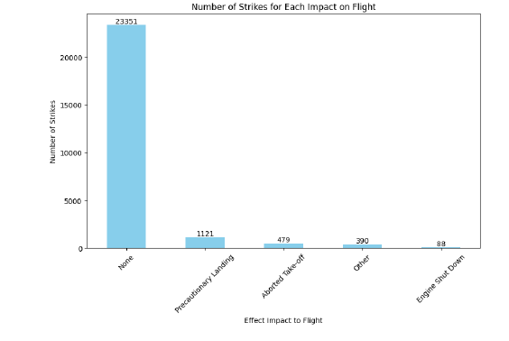
Average altitude of aeroplanes in different phases at the time of strike.
Effect of bird strikes & impact on flight

Slide 12
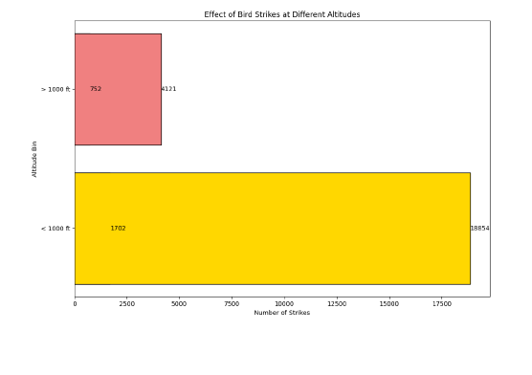
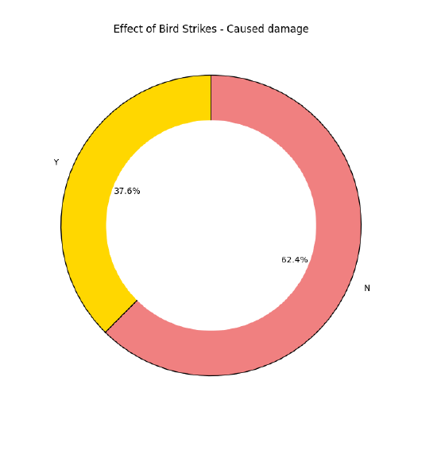
Effect of strike at different altitude
Prior Waring given to Pilots?

Slide 13
CONCLUSION
The findings contribute to our understanding of bird strike patterns, enabling informed decision-making for aviation safety measures.
As a foundation for future work, the project suggests opportunities for advanced modeling, risk assessment, and the development of targeted strategies to minimize the risk and impact of bird strikes.
The comprehensive analysis undertaken serves as a valuable resource for aviation stakeholders, guiding them in enhancing safety protocols and shaping the future of bird strike prevention in the industry.

Slide 14
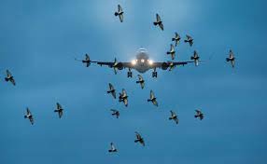
Thank you
M POOJA​​
poojaofficial968@gmail.com
www.linkedin.com/in/pooja-m-083556284

